Slide 1
CS 2600 Computer Networks I Dr. Sayeed Sajal Lecture 14 Framing

Slide 2

Figure 2.7 BISYNC Frame Format*
Bits:
SYN – Synchronize
SOH – Start of Header
STX – Start of Text
ETX – End of Text
CRC – Error Detection Code
Control (sentinel) characters
*This frame format was used at the Data-link layer with the IBM 3270 terminal (slide 13-3).
BISYNC is short for Binary Synchronous.

Slide 3
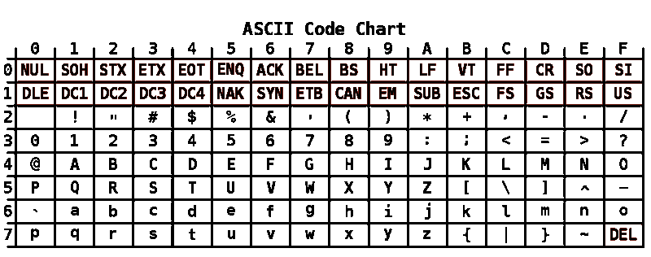
Original 7-Bit US-ASCII* Character Set
*American Standard Code for Information Interchange, also called US-ASCII. Left hand column
is left hex digit, top row is right hex digit. For example, the text character A is 41₁₆ and the
SYN control character is 16₁₆.

Slide 4
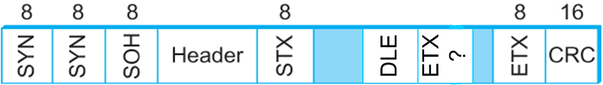
BISYNC Character Stuffing Using DLE Escape Character
Bits:
Body
Data with same
code as ETX
True ETX

Slide 5

Figure 2.8 PPP* Frame Format
Bits:
*Point-to-Point Protocol. DSL and cable modems use PPPoA (PPP over ATM) and
PPPoE (PPP over Ethernet).

Slide 6
Bit-Oriented Synchronous Data-link Layer Protocols*
HDLC “Immediate Family”
HDLC - High-Level Data Link Control (CCITT/ITU)
PPP - Point-to-Point Protocol for TCP/IP serial links
Logical Link Control (IEEE 802.2)
LAP-B - Link Access Protocol - Balanced Mode (HDLC Subset)
SDLC - Synchronous Data-Link Control (IBM)
LAP-M - Link Access Protocol - Modem (HDLC for Modems)
LAP-D - Link Access Protocol - D Channel (ISDN control channel)
ADCCP - Advanced Data Comm Control Protocol (old U.S. version of HDLC)
HDLC “Cousins”
Frame Relay
Ethernet (IEEE 802.3)
WiFi (IEEE 802.11)
Token Ring (IEEE 802.5)
FDDI - Fiber Distributed Data Interface (Fiber LAN)
“Distant Relatives” in Other Layers
X.25 (OSI Network Layer)
TCP (Internet Transport Layer)
*The Data-link layer protocols shown in red are covered in CS 2600

Slide 7
HDLC Frame Format
(Control Field for Unnumbered Frame not shown)

Slide 8
Some HDLC Terminology
HDLC Frame Types
Information (“I”) frames carry data in the PAYLOAD field that follows the header.
Supervisory frames don’t carry data. They are used for flow control and error control after the connection has been established.
Unnumbered Frames (not shown on previous slide) don’t carry data either. They are transmitted to establish and terminate connections, and to handle severe errors.
Flow control* is a mechanism that allows the receiver to tell the sender to slow down.
Error control* is the mechanism that the receiver uses to tell the sender that it received a bad frame.
*Important terms to know

Slide 9
The HDLC Bit Stuffing Algorithm
On the Send Side
The sender indicates the start and end of frame by transmitting the flag pattern (01111110).
2. When the sender needs to send a pattern containing five or more 1-bits in sequence, as data (i.e. between the flags), the sender’s hardware “stuffs” in a 0 after the fifth 1-bit. (The five 1-bits may span two bytes.)
On the Receive Side
When the receiver sees an incoming pattern of five 1-bits, it checks the next bit:
3. If the sixth bit is 0, that bit is deleted, restoring the data pattern to its original form.
4. If the sixth bit is 1 and the seventh bit is a 0, this is a flag marking the beginning or end of the frame. (Flags are discarded after being received.)
5. If the sixth bit is a 1 and the seventh bit is also a 1, an error has occurred (seven or more 1-bits in a row) and the entire frame is discarded. The sender will never transmit more than six consecutive 1-bits.

Slide 10
HDLC Bit Stuffing Examples
8-bit data pattern Changed by send Changed by receive
appearing between hardware to: hardware back to:
Flags: (Rule 2.) (Rule 3.)
1. 01111110 011111010 01111110
2. 01111100 011111000 01111100
3. 01111111 011111011 01111111
------------------------------------------------------------------------------------------------------------------
Intentional Flag No change by Flag marks start or end
pattern: send hardware of message
(Rule 1.) (Rule 4.)
4. 01111110 01111110 01111110
------------------------------------------------------------------------------------------------------------------
Intentional Flag Transmission Illegal > 6 1-bits pattern,
pattern: error: message is discarded by
receiving hardware (Rule 5.)
5. 01111110 01111111 01111111

Slide 11
Comparing HDLC and PPP

Slide 12
Homework Question 5.
5. Assuming a framing protocol that uses bit stuffing, show the bit sequence transmitted over the link when the frame contains the following bit sequence between the flags, prior to bit stuffing. (Assume this sequence is just a small part of the overall frame.)
11010111 11010111 11101011 11111011
Underline the stuffed bits that you added. Use slides 14-9 and 14-10 for reference.

Slide 13
Homework Question 6.
6. Suppose the following sequence of bits arrive over a link:
11010111 11010111 11001011 11101101 11111101
Show the resulting bit pattern after any stuffed bits have been removed. Indicate any transmission errors that might have occurred.

